Slide 1
Brunel University Buy And Sell
Group 15

Slide 2
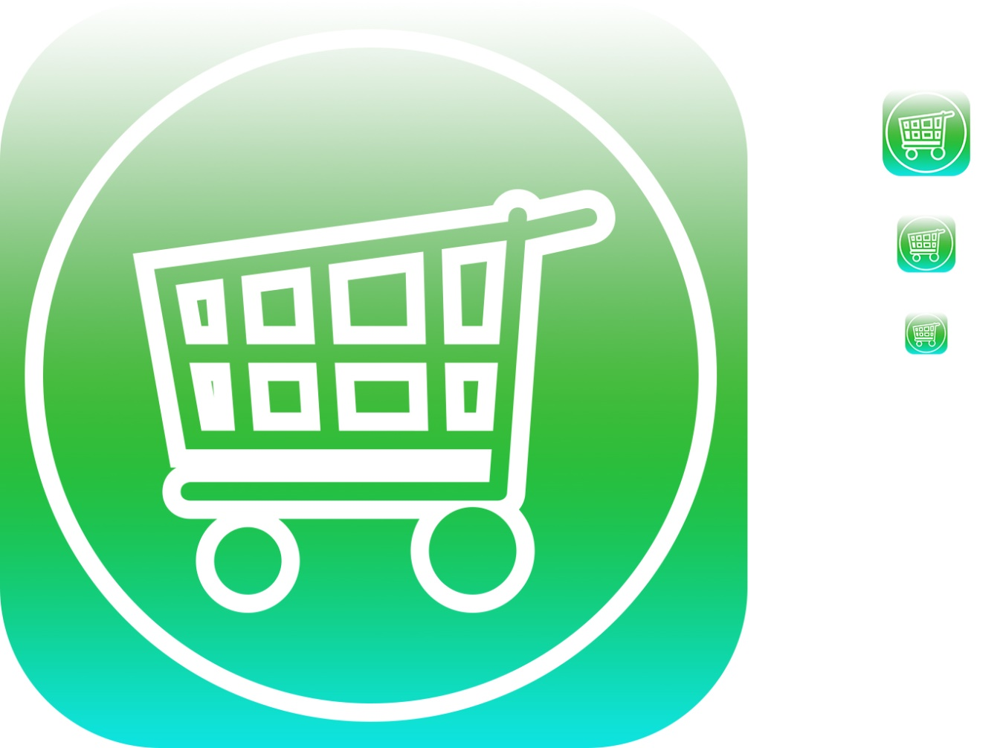
App Icon Ideas
We wanted to design a simple yet recognisable.
The logo itself was designed in Adobe Photoshop and was designed in different resolutions depending on what device was being using
This was the first design however we decided to change the colours in the next one.

Slide 3




Design Iterations
We liked the idea but had decided to change the colour of the icon.
We decided that because the app was going to be for Brunel students that it would be better to have a colour that was close to the Brunel logo (Dark Blue)
Bellow are some examples of App Icons that were created.

Slide 4

Final Design Idea
This was the final design idea that we ended up agreeing with.
We decided that a flat colour would be better as it would be easier to spot.
The resolutions of the icons were:
1024px x 1024px
120px x 120px
80px x 80px
58px x 58px

Slide 5
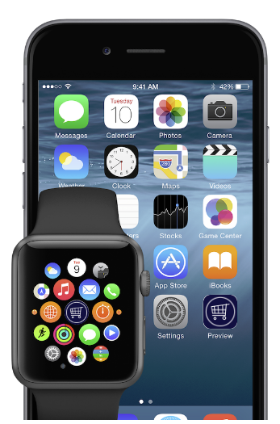
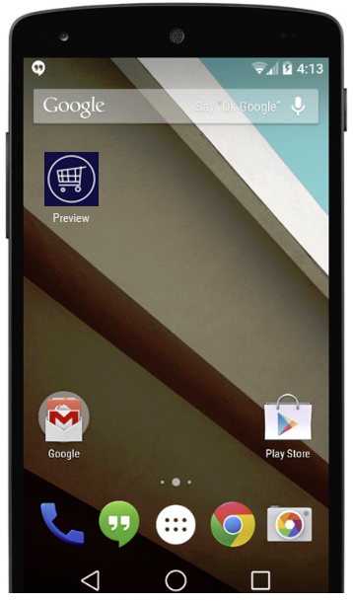
What will it look like on a device.
Here are some renders that were generated in order to get an idea what the App icon should look like once it is on a device. Although we are creating an Android app I had created a render for iOS so that if in the future we decided to create an iOS app then we would have some idea of what it would look like.

